Slide 1
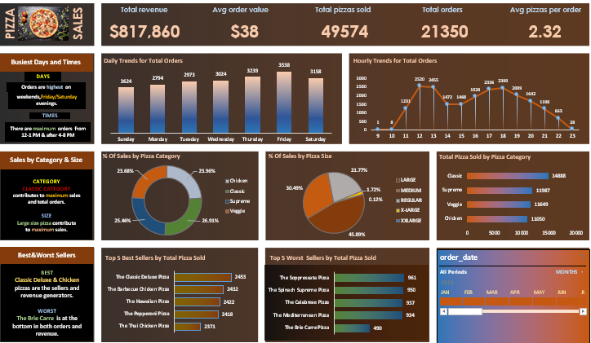
MS EXCEL DASHBOARD

Slide 2
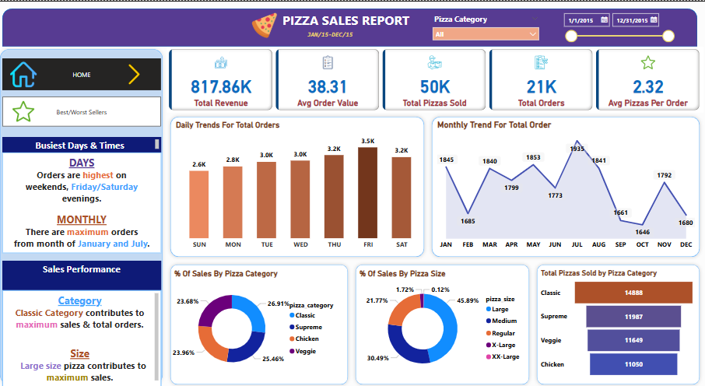
POWER BI DASHBOARD

Slide 3
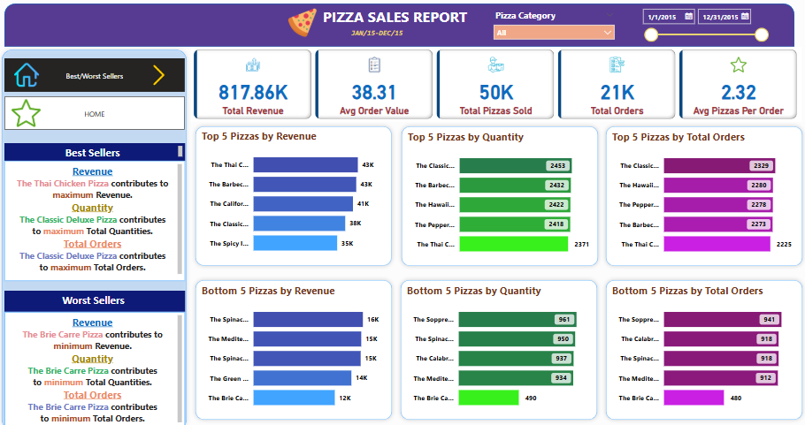
POWER BI DASHBOARD

Slide 4
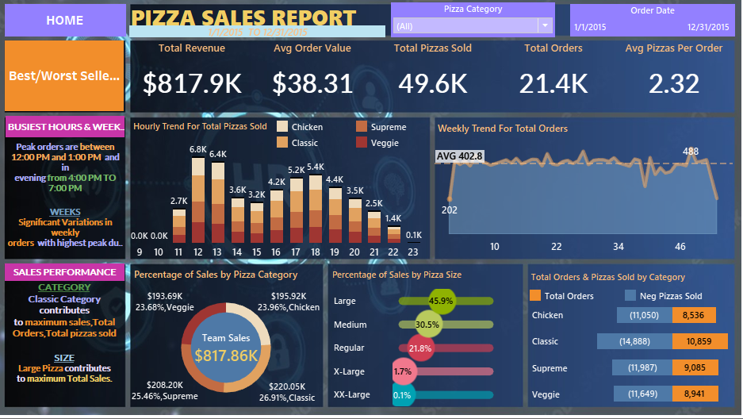
TABLEAU DASHBOARD

Slide 5
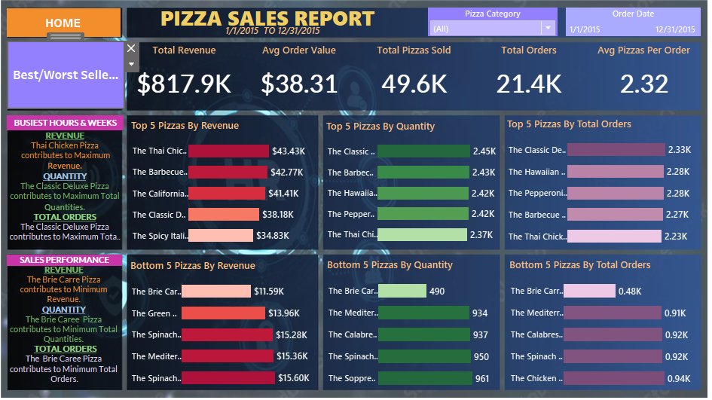
TABLEAU DASHBOARD

